Slide 1

BLUETOOTH-CONTROLLED TABLE TENNIS SERVE MACHINE final evaluation
PREPARED BY:
2020/E/059 – JAYATHILAKA N.M.R.K.
2020/E/060 – JAYATHISSA H.M.N.D.
2020/E/063 – JEYASINGAM K.

Slide 2
TABLE OF CONTENTS
INTRODUCTION
PROBLEM STATEMENT
SOLUTION
SCOPE
COMPLETE DESIGN OF FINAL PRODUCT
SOFTWARE PROCESS
REVISED COST
MARKETIZING METHOD – POSTER
PROBLEM FACED

Slide 3


Slide 4
INTRODUCTION
Table tennis is a popular sport enjoyed by people of all ages and skill levels.
One of the key aspects of table tennis is mastering different types of serves.

Slide 5
Problem statement
Practicing table tennis serves alone can be difficult, as players often struggle to maintain consistency variety in their practice session.
Without a training partner to provide feedback and variation in serves, players may find challenging to improve their skills effectively.

Slide 6
solution
We have developed a solution, TABLE TENNIS SERVE MACHINE that automatically serves table tennis balls with adjustable parameters such as speed, spin, and placement.
It’s a versatile tool for a solo practice session.
Notes:
machine will consist of the following key components:
Servo-controlled ball release mechanism
Bluetooth module for remote control
Microcontroller to manage the machine's operations
Mobile application for user control and customization

Slide 7
scope
The project will involve the implementation of a feedback system to provide users with real-time performance metrics and progress tracking.
The machine will be designed to be easy to use, making it suitable for use in various places such as homes, schools, and table tennis clubs.

Slide 8
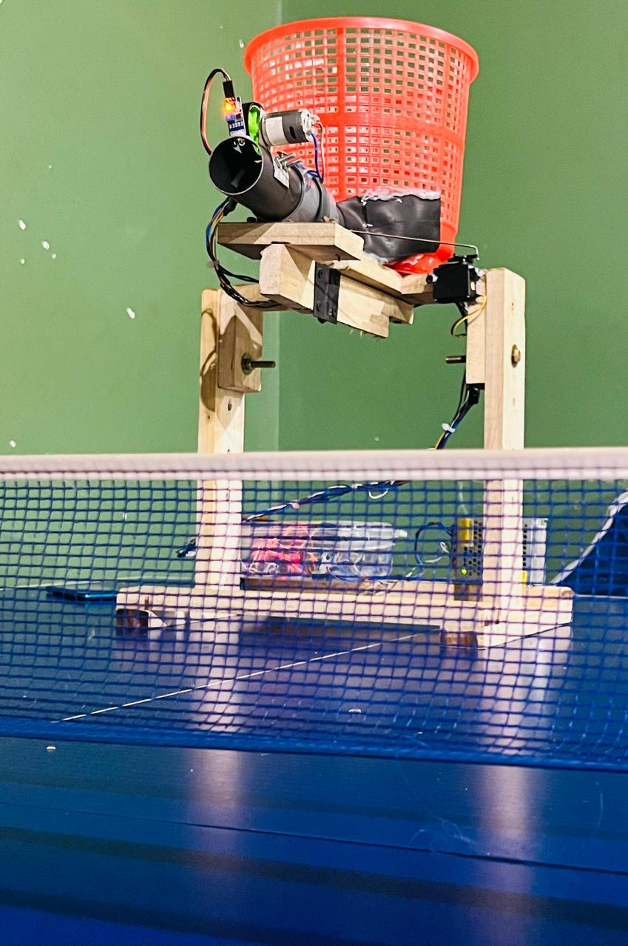
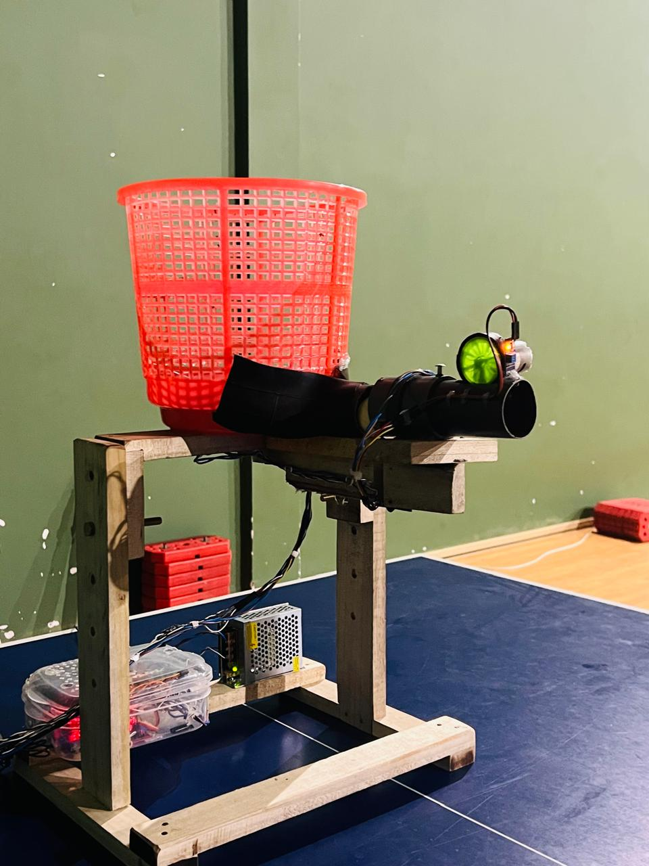
COMPLETE DESIGN

Slide 9
Software process

Slide 10
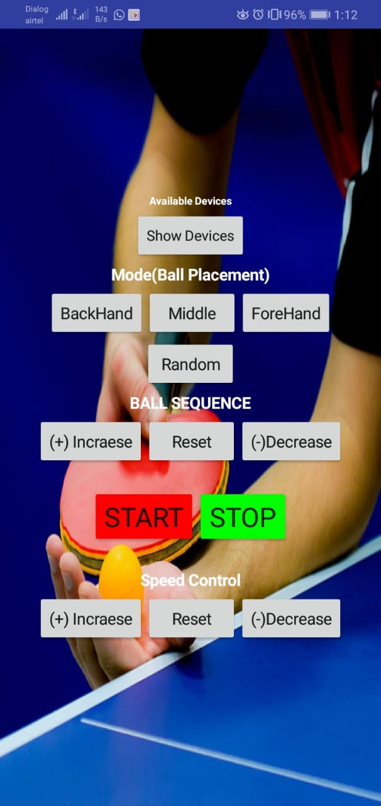
Mobile app development & architecture
https://ai2.appinventor.mit.edu/#6673731233579008

Slide 11
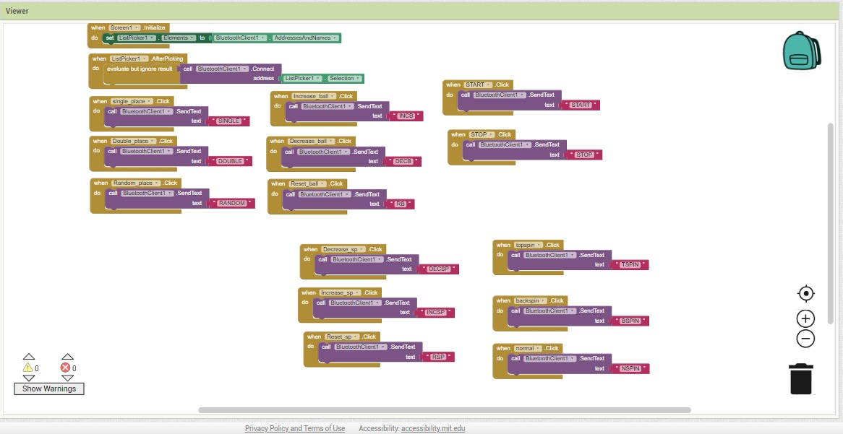
Mobile app development & architecture

Slide 12
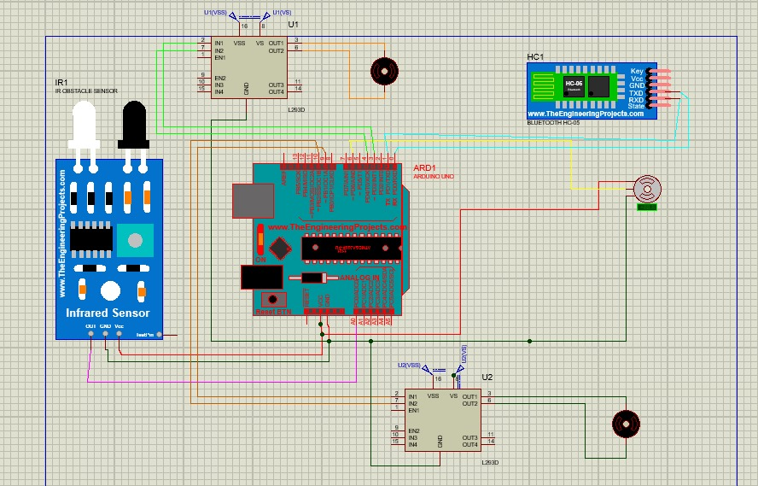
SIMULATION ON PROTEOUS SOFTWARE
Notes:
Bluetooth module HC05
Bluetooth protocol USART (universal synchronous and asynchronous receiver and transmitter

Slide 13
Revised cost
NAME | QTY | PRICE
DC 550 (22000 rpm) | 2 | 2000
Servo motor | 1 | 970
Tt motor(gear) | 1 | 200
IR sensor | 1 | 120
Arduino mega, uno | 1 | --
L293d motor controller | 2 | 1040
Bluetooth Arduino module (HC-05 or HC-06) | 1 | 1000
Jumper wires | Male-male 10 Female-female10 | --
 | 1 | --
Power supply 12v | 1 | 1900
Additional structure cost |  | 1000
TOTAL | 8230/=

Slide 14
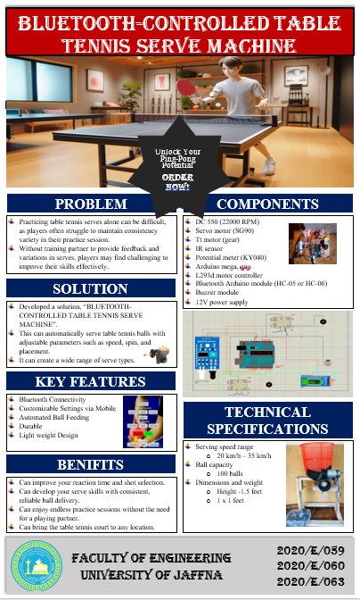
marketize

Slide 15
Problems faced
Power management was very tough.
We can’t working on calculation. Because wind speed, humidity, ball material will change lot of things. So need to the physical tests.
Calibration in different environments user need specialist help.
Accessing engineering workshop was very difficult.

Slide 16

Special Thanks To….
Mr.Keshavan

Slide 17
Thank you!

